Slide 1
Demand, Supply, and Market Clearing
Rajiv Sethi and the CORE Team
November 3, 2021

Slide 2
Overview
Market demand and supply
Market clearing
Excess demand and supply
From marginal cost to market supply
Consumer surplus and producer surplus
Deadweight loss under competitive conditions
Reading: The Economy Unit 8 Introduction, 8.1 to 8.5

Slide 3
Market Demand and Supply

Slide 4
Example
Consider the market for physical copies of the textbook for this course
Since the e-book is available free of charge online, you can do without
But if book is cheap enough, you may buy a physical copy
Willingness-to-pay or reservation price will vary across individuals
Resulting in a downward-sloping demand curve
This plots the hypothetical demand at various prices
The lower the price, the greater the demand

Slide 5
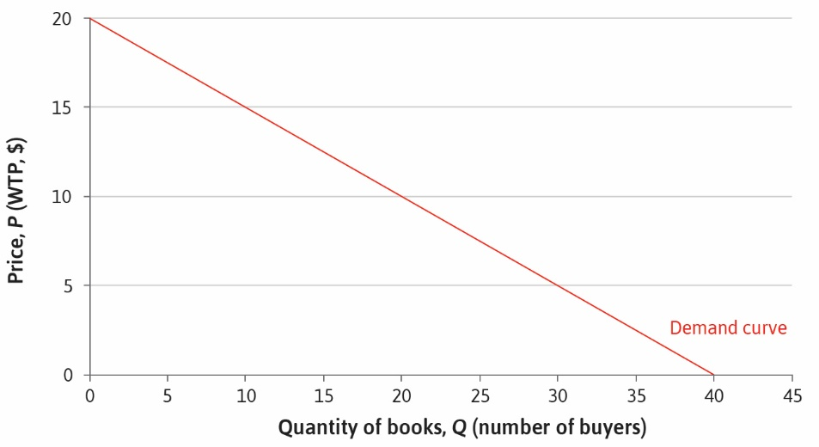

Slide 6
Example (continued)
Now consider supply
There’s a stock of books out there, some new some used
Consider just new copies (so we don’t have to worry about condition)
Owners of the book will be willing to sell if price is high enough
But minimum acceptable price will vary across sellers
Resulting in an upward-sloping supply curve
This plots the hypothetical supply at various prices
In fact, the supply curve can be seen by looking at posted prices

Slide 7


Slide 8
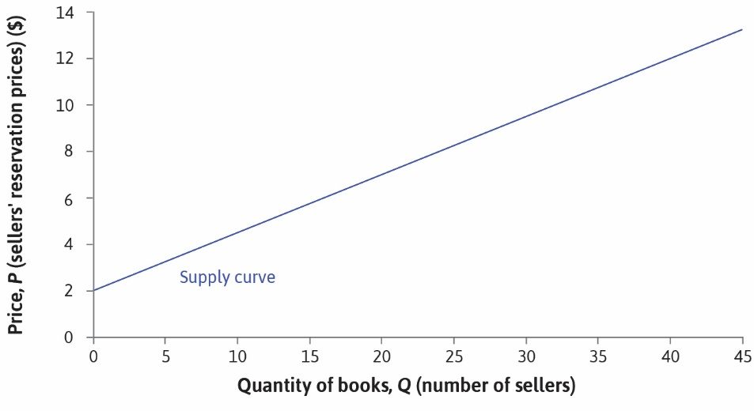

Slide 9
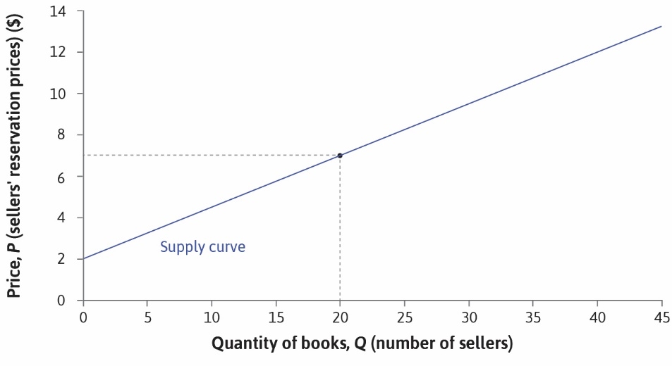

Slide 10
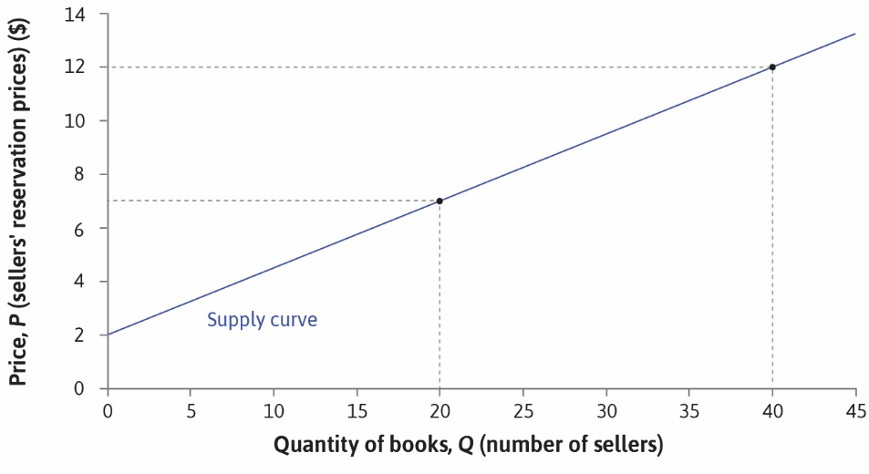

Slide 11
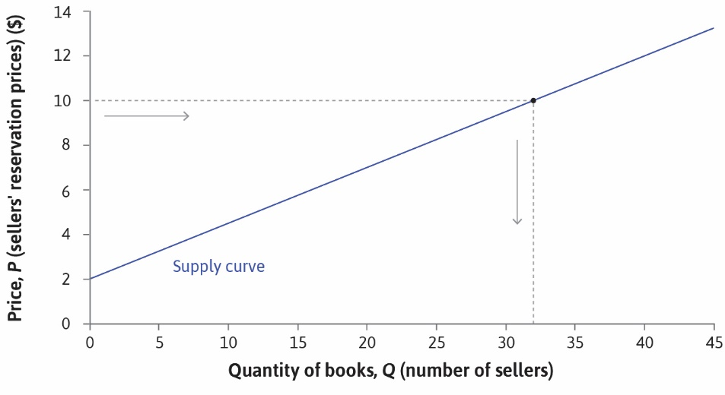

Slide 12
Market Clearing
The market is said to clear if the price is such that supply equals demand
The price at which this occurs is the equilibrium or market clearing price
The quantity demanded/supplied at this price is the equilibrium quantity
If the price is too high there is excess supply
If the price is too low there is excess demand
Many sellers deliberately set prices at levels with excess demand
Examples: some restaurants, concerts, sporting events
Others set prices with excess supply (most posted price markets)
Why do they do this?

Slide 13
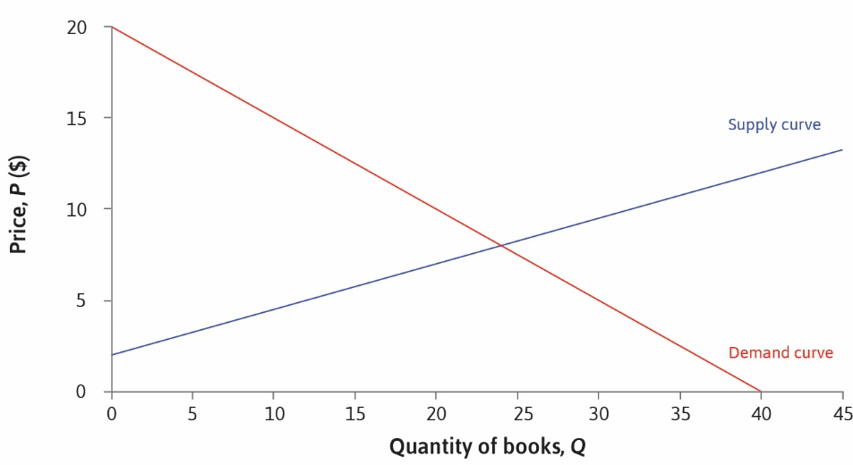

Slide 14
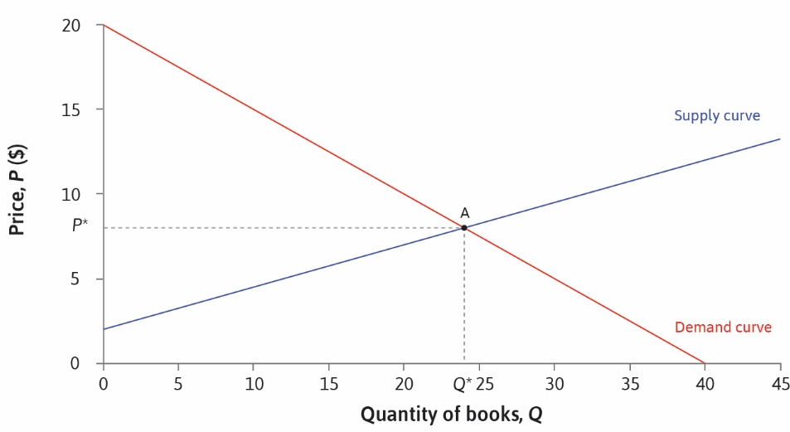

Slide 15
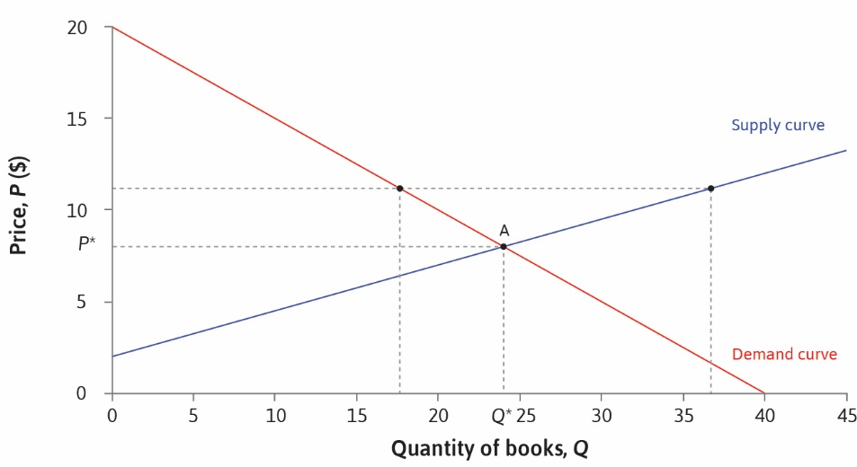

Slide 16


Slide 17
Production and Supply
What is the connection between costs of production and supply?
Consider a small firm that doesn’t set price at all: a price-taker
Must sell at whatever price is prevailing in the market
Examples: producers of oil, grain, minerals, metals
Then the demand curve is horizontal at the market price
The firm can’t sell above market price
But can sell as much as it wants at prevailing price
Provided it remains small relative to the market
How much will it produce at the prevailing price?

Slide 18
Costs
For the price-taking firm, production (supply) will depend on costs
Recall: isoprofit curve with zero profit is the AC curve
And the MC curve intersects the AC curve at lowest point of the latter
At any given price, supply will be at highest attainable isoprofit curve
Given horizontal price line, tangency is at lowest point of isoprofit curve
This is also where it intersects the MC curve (next slides)

Slide 19
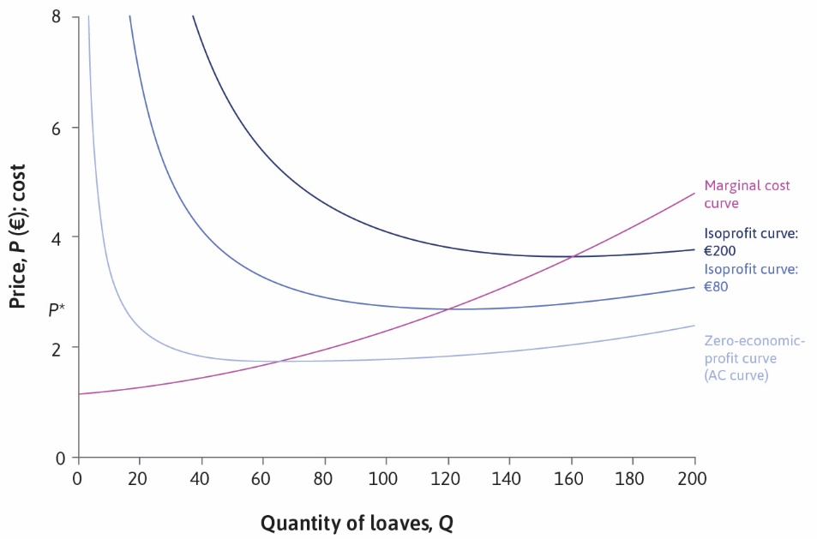

Slide 20
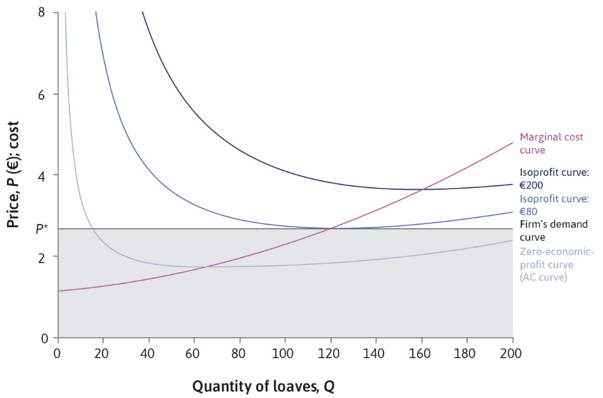

Slide 21
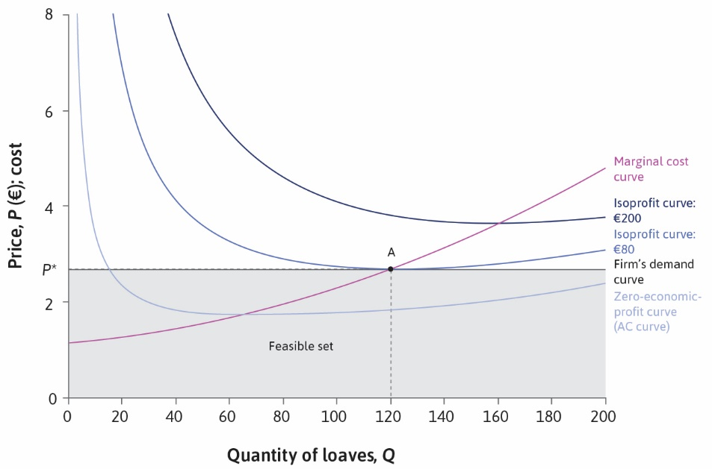

Slide 22
Firm Supply
As price changes, so does production (supply)
It does so in a way that follows the MC curve
With rising marginal costs, higher prices result in greater supply
So we get a rising supply curve for a firm

Slide 23
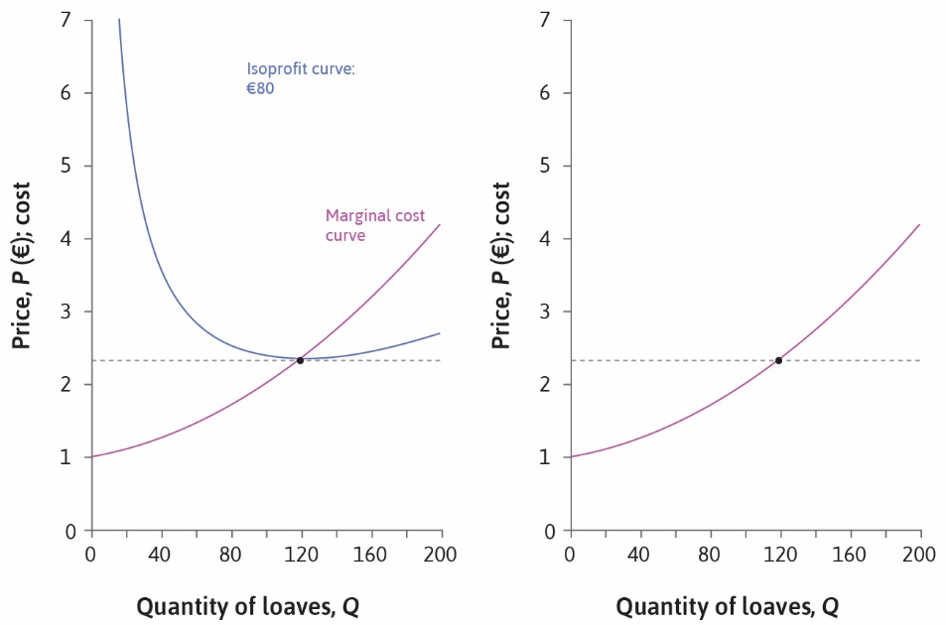

Slide 24
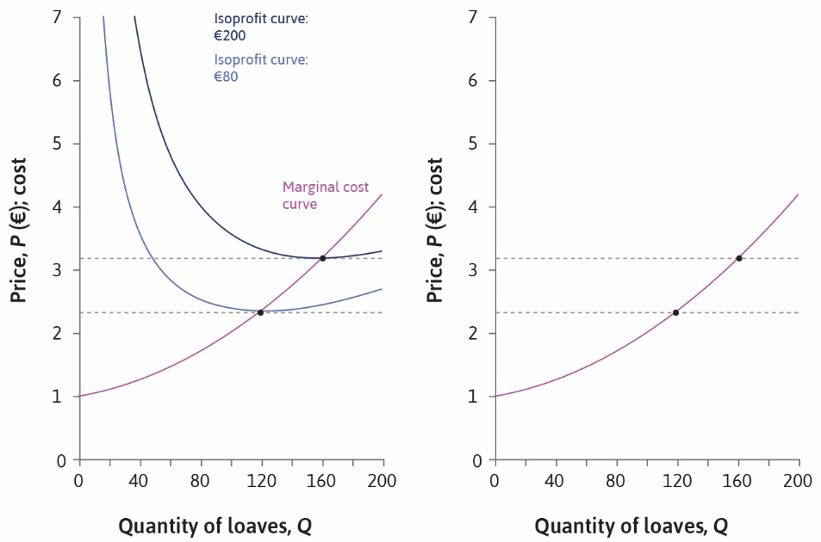

Slide 25
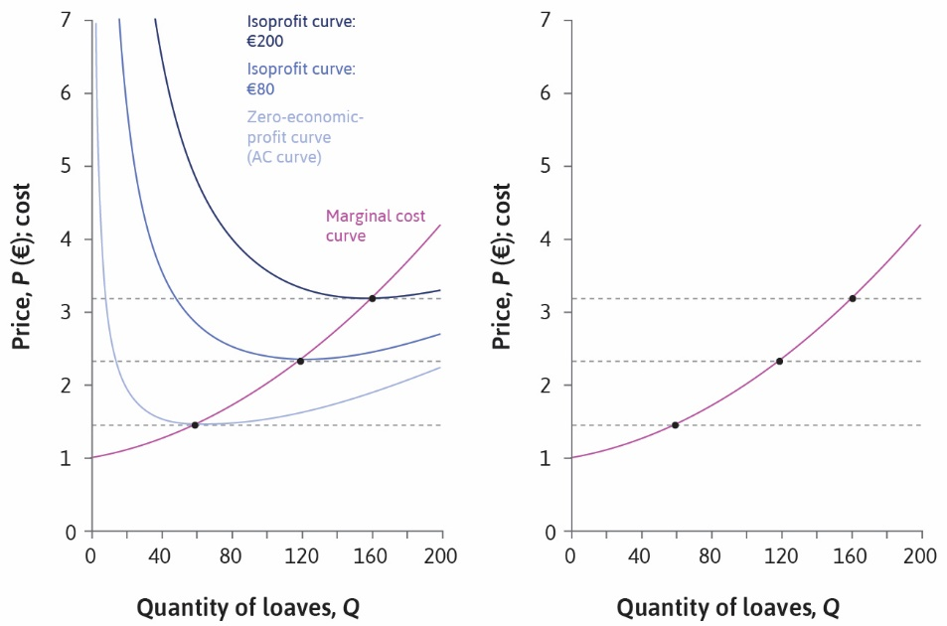

Slide 26
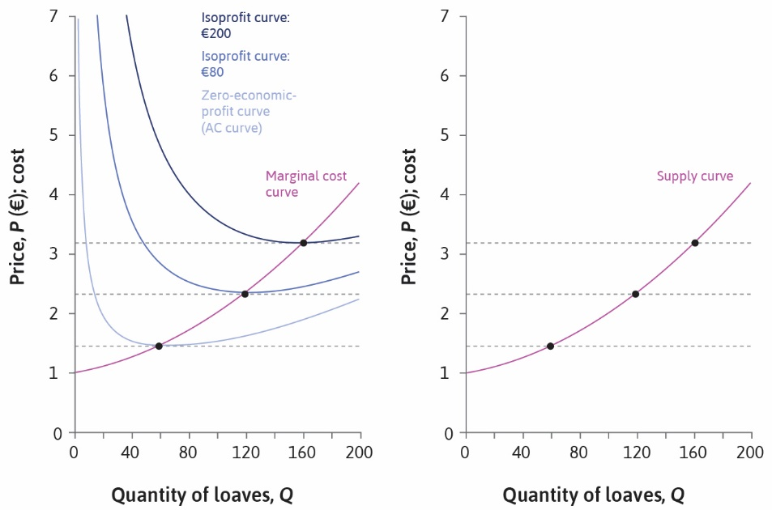

Slide 27
Market Supply
To get the supply curve for the market, we aggregate across firms
If each firm has a rising supply curve, then so does the market
At any price, market supply is the sum of all firm supplies
And equilibrium price is that which equates market supply and demand

Slide 28
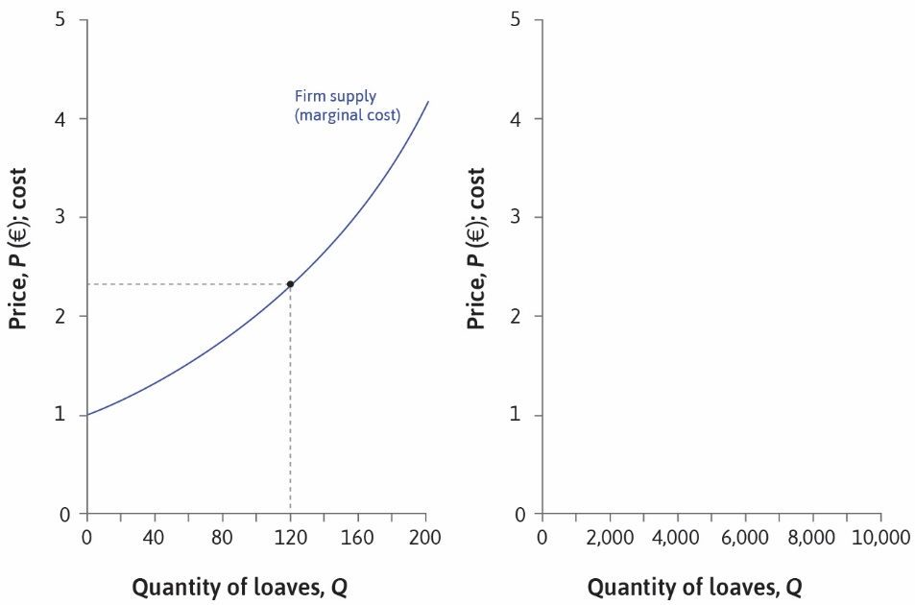

Slide 29
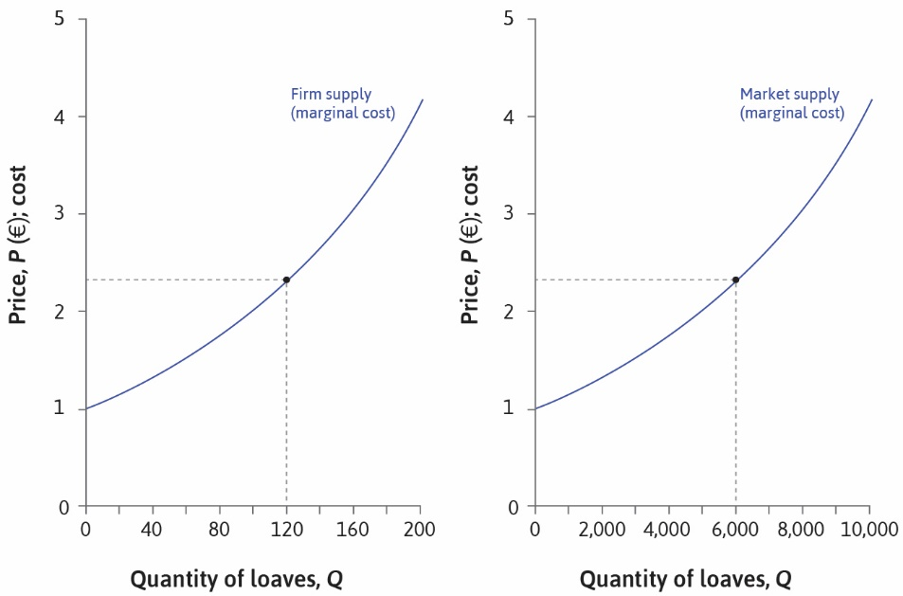

Slide 30
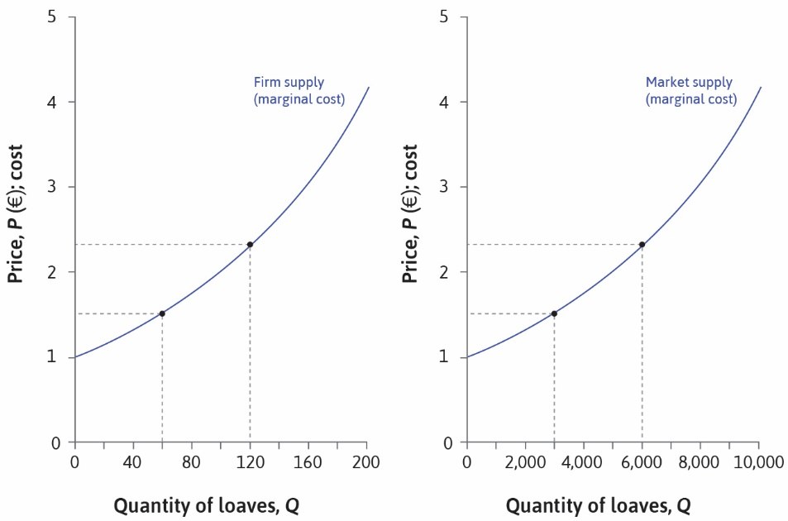

Slide 31
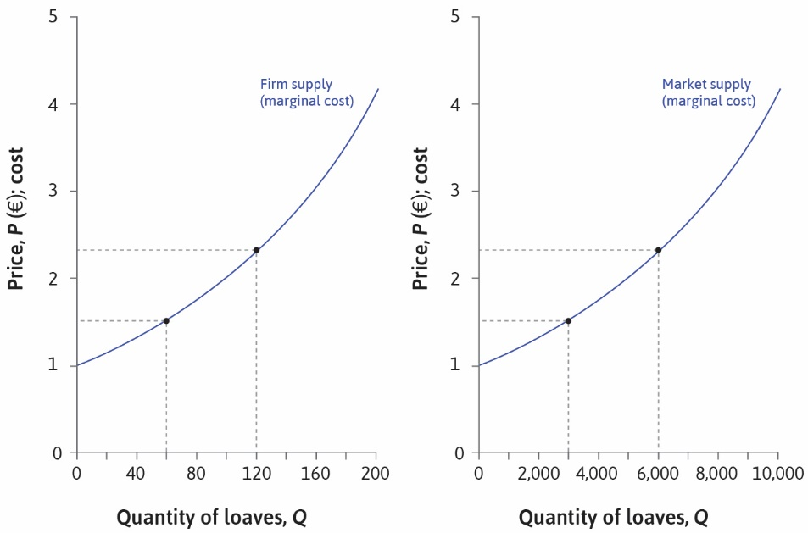

Slide 32
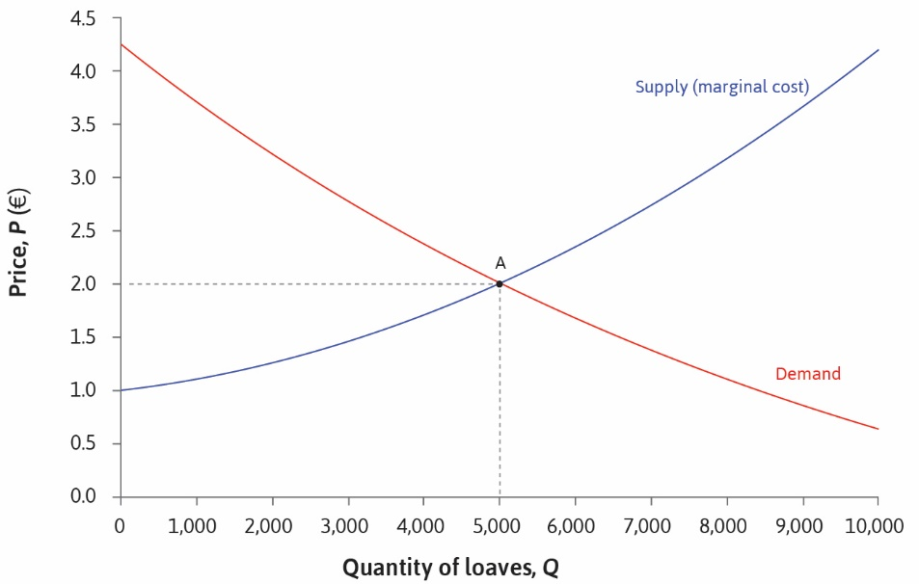

Slide 33
Deadweight Loss
As before, consumer surplus is area above price, below demand
And producer surplus is area below price and above supply
Note: producer surplus is not the same as profit (ignores fixed costs)
In the special case of price-taking firms (small relative to market)
Total surplus is maximized at equilibrium price
So there is no deadweight loss
But this is not true when firms have market power, can set price

Slide 34
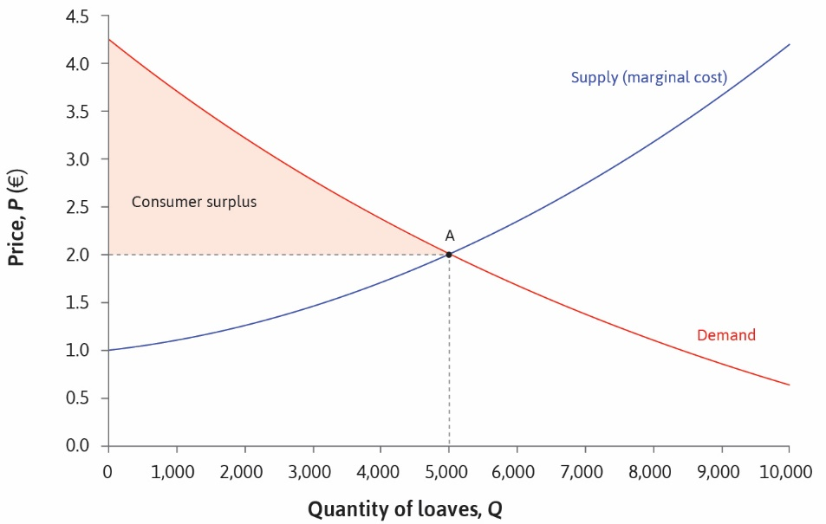

Slide 35
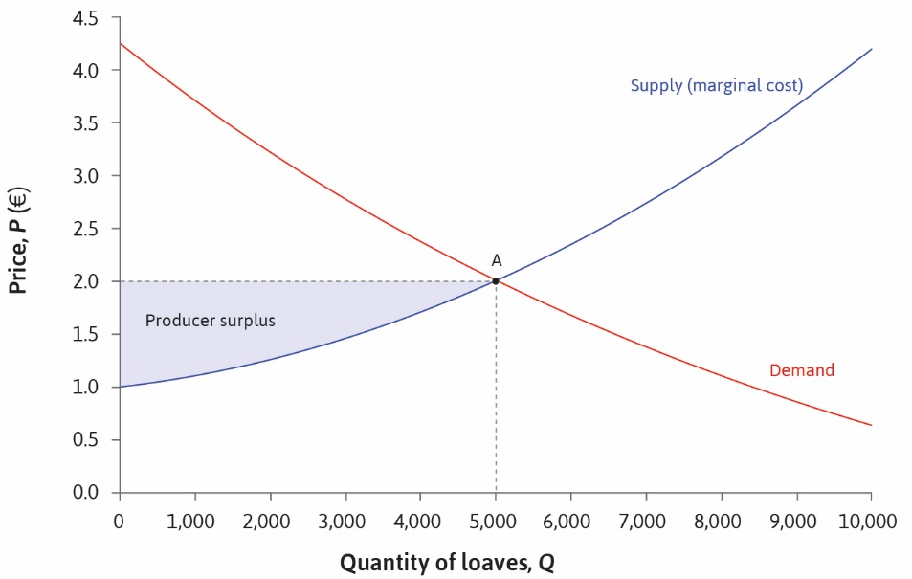

Slide 36
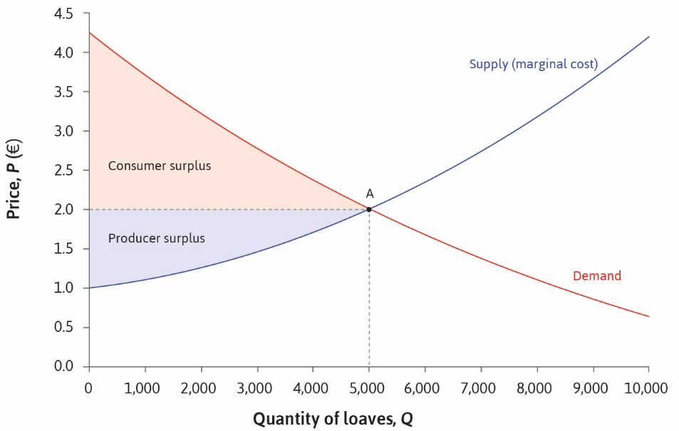

Slide 37
